Slide 1
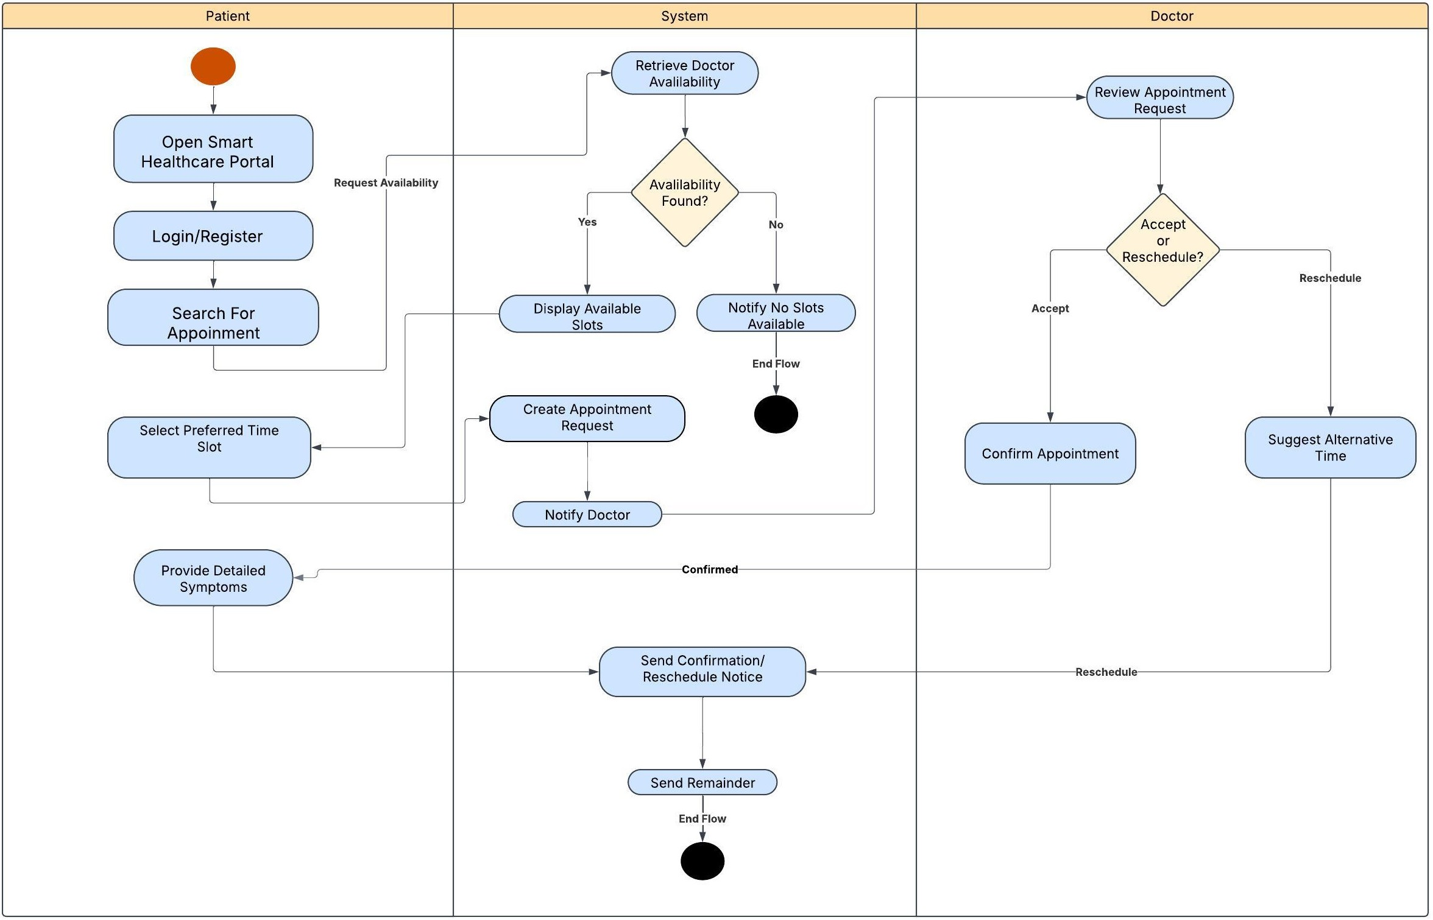
Activity Diagram: Smart Healthcare Appointment

